Slide 1
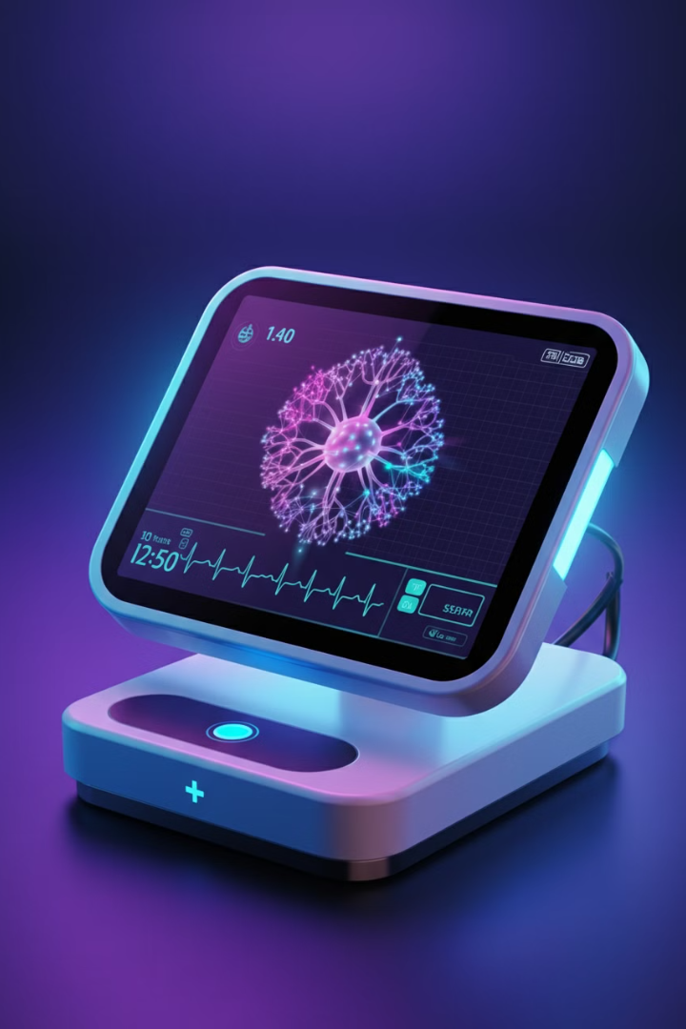
An Evolutionary Deep Learning Framework for Automated ECG Arrhythmia Classification
This presentation introduces a novel computational framework that combines particle swarm optimization with convolutional neural networks to automatically classify cardiac arrhythmias from ECG signals. The system optimizes neural network architectures without manual configuration, enabling robust performance across multiple arrhythmia types.
NN

Slide 2

Key Objectives
Innovative Hybrid Framework
Automated Optimization
Develop a system combining particle swarm optimization and convolutional neural networks for accurate arrhythmia classification
Design an automated hyperparameter optimization system to eliminate manual architecture configuration
Efficient Error Minimization
Clinical Validation
Validate the framework's effectiveness through comprehensive testing on standard ECG datasets
Create a system that minimizes categorical cross-entropy error while providing robust multi-class arrhythmia detection

Slide 3
Limitations of Existing Systems
Traditional Machine Learning
Basic Deep Learning
Support Vector Machines and decision trees require extensive manual feature engineering and struggle with complex ECG patterns. K-Nearest Neighbors methods become impractical with large datasets.
Current CNN architectures often need manual design. Pre-trained networks like ResNet may not be optimized for ECG analysis. RNNs and LSTMs are used for time-series data but can be computationally intensive.

Slide 4




Innovative Aspects of Proposed System
Automated Configuration
Novel Search Strategy
Efficient Integration
Reduced Setup Time
PSO-based approach for finding optimal hyperparameters with dynamic adjustment of optimization criteria
Real-time optimization feedback loop between PSO and CNN for flexible architecture adaptation
Minimal technical expertise required for deployment with consistent performance across datasets
Eliminates manual setup using particle swarm optimization to dynamically explore network structures

Slide 5

Problem Statement
The healthcare industry faces significant challenges in accurately detecting and classifying cardiac arrhythmias through ECG analysis. Current systems heavily depend on both medical expertise for interpretation and technical knowledge for system configuration, creating a substantial bottleneck in healthcare delivery.
Traditional approaches require extensive manual tuning of machine learning parameters or deep learning architectures, making them impractical for many healthcare facilities that lack specialized AI expertise. This limitation often forces medical institutions to either invest heavily in technical specialists or rely on less sophisticated analysis tools that may miss critical cardiac patterns, potentially affecting patient care quality and diagnosis speed.

Slide 6




Challenges with Existing ECG Analysis Systems
Lack of Adaptability
1
Fixed architectures struggle with diverse patient populations
High Resource Requirements
2
Computational and resource costs create implementation barriers
Manual Intervention Needed
3
Extensive tuning required for optimal performance
Limited Accessibility
4
Specialized expertise needed for deployment and maintenance
These challenges highlight the urgent need for a more adaptive and efficient approach to ECG analysis that minimizes manual intervention while ensuring reliable diagnostic support.

Slide 7

Motivation for Automated Arrhythmia Classification
Global Health Impact
Resource Constraints
Heart diseases affect millions worldwide, creating an urgent need for effective ECG analysis tools.
Many hospitals lack expert cardiologists and technical specialists, hindering timely cardiac care.
Data Explosion
Accessibility
Modern monitoring devices generate massive amounts of ECG data that overwhelm traditional analysis methods.
Automated systems can make advanced cardiac analysis available to underserved regions and smaller facilities.

Slide 8





Benefits of Automated ECG Analysis
Reduced Operational Costs
Improved Patient Care
Increased Accessibility
Enhanced Efficiency
Processes large volumes of ECG data quickly and accurately
Minimizes need for technical specialists
Enables faster, more reliable arrhythmia detection
Makes advanced analysis available to more healthcare providers

Slide 9
MIT-BIH Arrhythmia Dataset
Dataset Overview
Key Characteristics
48 half-hour recordings of two-channel ambulatory ECG
Over 109,000 labeled heartbeats
Obtained from 47 subjects at Beth Israel Hospital
5 main arrhythmia classes
Digitized at 360 samples per second per channel
Includes both clean signals and those with noise
11-bit resolution over a 10mV range
Annotations provided by expert cardiologists

Slide 10
Data Preparation Process
1
Signal Preprocessing
Remove noise and baseline wander from raw ECG signals
2
Segmentation
Divide continuous ECG signals into individual heartbeats
3
Normalization
Standardize signal amplitude across all samples
4
Balanced Sampling
Address class imbalance issues in the dataset
5
Cross-validation Splits
Prepare data for robust model evaluation

Slide 11

Core Algorithms: Particle Swarm Optimization (PSO)
Particle Swarm Optimization serves as our automatic architecture optimizer, mimicking the behavior of bird flocks to find optimal solutions. Each particle represents a different CNN architecture configuration, moving through a solution space and adjusting based on personal and group best findings.
Particle Information
Continuous Updates
Holds data on network parameters like number of layers, filter sizes, and learning rates
PSO constantly adjusts parameters based on network performance metrics
Optimization Focus
Primarily targets classification accuracy and loss values

Slide 12
Core Algorithms: Convolutional Neural Network (CNN)
Our CNN is specifically designed for ECG signal processing, with a flexible structure optimized by PSO. Key elements include:
1
Input Layer
Accepts normalized ECG segments
2
Convolutional Layers
Learn hierarchical features from ECG signals
3
Activation and Normalization
ReLU activation and batch normalization
4
Pooling and Dropout
Max pooling and dropout for feature selection and overfitting prevention
5
Output Layer
Softmax for five-class arrhythmia classification

Slide 13
Integration of PSO and CNN
Symbiotic Relationship
Training Optimizations
PSO continuously fine-tunes the CNN architecture and hyperparameters based on performance metrics. This eliminates the need for manual architecture design while ensuring optimal classification performance.
The system uses Adam optimization for training, with an adaptive learning rate mechanism. Categorical cross-entropy serves as the loss function. Early stopping and learning rate scheduling prevent overfitting and ensure stable convergence.

Slide 14

Recent Advancements in ECG Analysis
1
2021: PSO-Enhanced BP Neural Networks
Zhang et al. achieved 96.5% accuracy with 45% reduced convergence time
2
2022: Hybrid Deep Learning
Sharma et al. reached 97.8% accuracy using 8 convolutional layers
3
2023: Efficient 1D CNN
Rahman et al. attained 98.1% accuracy with a lightweight model
4
2024: Deep Residual Attention Network
Kumar et al. achieved 99.2% accuracy with residual learning and attention mechanisms

Slide 15

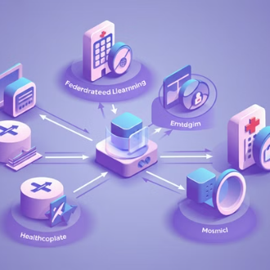

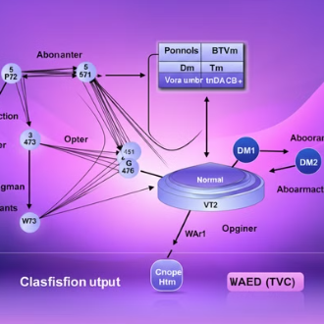

Innovative Approaches in Recent Literature
Recent research has explored quantum-inspired neural networks, federated learning for privacy-preserving analysis, 3D-CNN architectures, graph neural networks for temporal data, and explainable AI approaches for interpretable results.

Slide 16
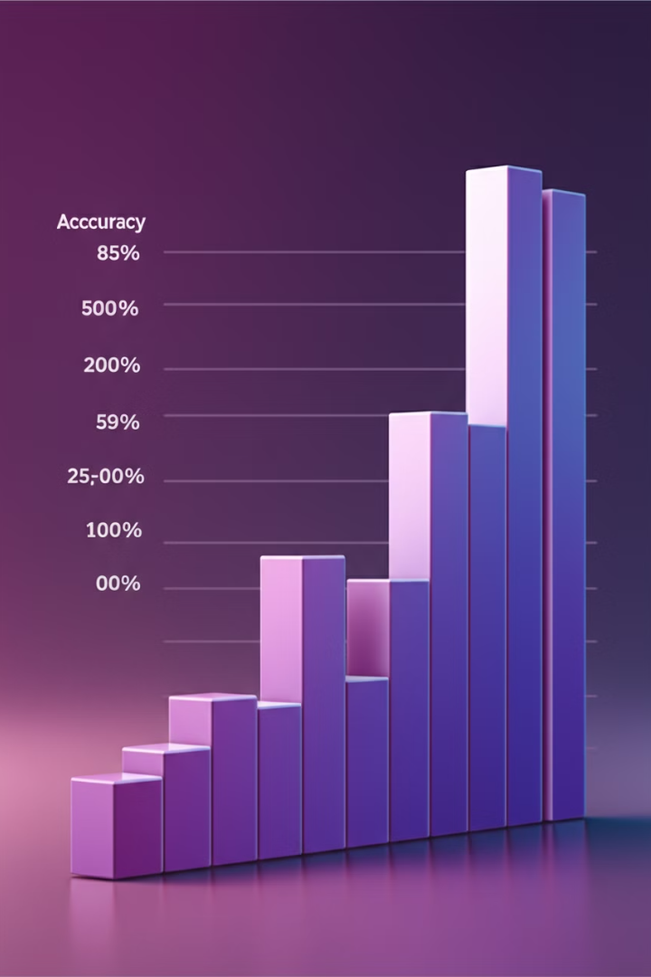
Performance Metrics of Recent Studies
Study
Accuracy
Key Feature
Lee et al. (2024)
99.1%
Quantum-inspired NN
Chen et al. (2024)
99.2%
Transformer-GAN hybrid
Rodriguez et al. (2024)
99.3%
Hierarchical ensemble
Thompson et al. (2024)
99.4%
Multi-modal fusion
Patel et al. (2024)
98.8%
Interpretable deep learning

Slide 17





Emerging Trends in ECG Analysis
Quantum Computing
Federated Learning
Leveraging quantum principles for complex pattern recognition
Enabling collaborative learning while preserving data privacy
Explainable AI
Edge Computing
Providing interpretable results for clinical decision support
Bringing ECG analysis capabilities to wearable devices

Slide 18
Challenges and Future Directions
Current Challenges
Future Research Directions
Balancing model complexity with real-time performance
Exploring quantum-classical hybrid models for ECG analysis
Ensuring robustness across diverse patient populations
Integrating multi-modal data for comprehensive analysis
Developing zero-shot learning approaches for rare arrhythmias
Addressing privacy concerns in collaborative learning setups
Enhancing interpretability of deep learning models
Investigating adaptive models for long-term ECG monitoring

Slide 19
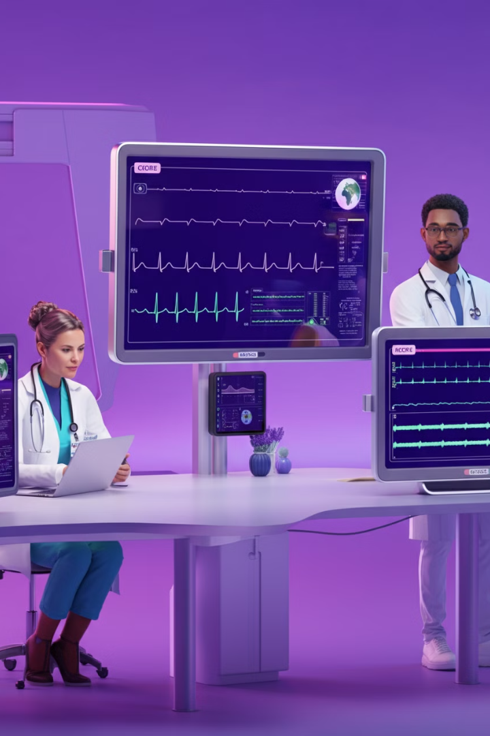
Potential Impact on Healthcare
Improved Diagnosis
Personalized Treatment
More accurate and timely detection of cardiac arrhythmias
Tailored interventions based on individual ECG patterns
Resource Optimization
Global Accessibility
Efficient allocation of medical expertise and resources
Bringing advanced cardiac care to underserved regions

Slide 20

Conclusion and Next Steps
Our proposed evolutionary deep learning framework for ECG arrhythmia classification represents a significant advancement in automated cardiac analysis. By combining particle swarm optimization with convolutional neural networks, we've created a system that adapts to diverse ECG patterns while maintaining high accuracy.
1
Validate on Diverse Datasets
2
Clinical Trials
Conduct real-world evaluations in hospital settings
Test the system's performance across multiple ECG databases
3
Integration with EHR Systems
4
Continuous Learning Framework
Develop interfaces for seamless integration with existing healthcare IT
Implement mechanisms for ongoing model improvement with new data

